Slide 1

Last Update: May, 2021

Slide 2
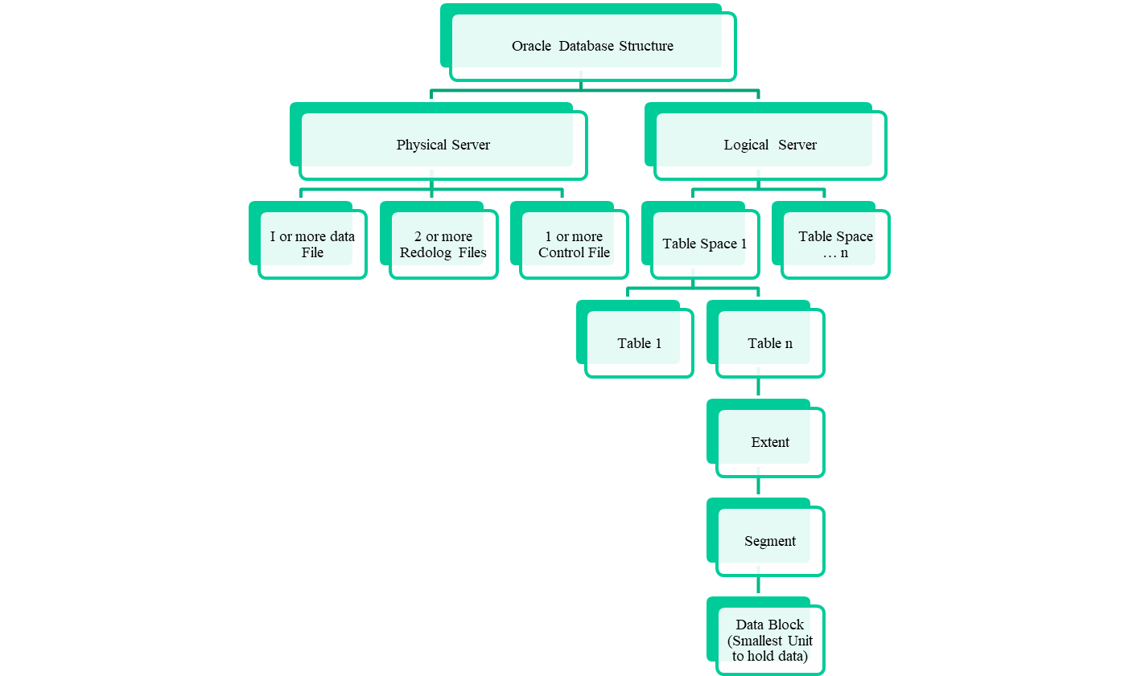
Oracle Database Structure

Slide 3
Database and Tablespace
Physical
Logical
Hard disk
Database Names
HD-1
Data1.dbf
User-1
HD-2
Data2.dbf
User-2
HD-3
Data3.dbf
User-3
HD-4
Data4.dbf
User-4

Slide 4
Segment
Oracle Database uses 4 type segment
  Data Segment (Store users data)
  Index Segment (Store index)
  Rollback Segment (Store rollback information)
  Temporary Segment ( SQL statements use before ending run)

Slide 5
User/Schema
User
  SYS (Default)
  SYSTEM (Default)
  RASHID (Additional user should be create as DBA privilege )
User | Difference
SYS | Sql>CONN sys as sysdba Sql>SHOW USER; Sql>select * from tab;
SYSTEM | Sql>CONNECT system/system@napd; Sql>SHOW USER; Sql>select * from tab;
RASHID | Sql>CONNECT rashid/tiger@napd Sql>SHOW USER; Sql>select * from tab;
Oracle Course

Slide 6
Administrative User Accounts
Two administrative user accounts are automatically created when Oracle Database is installed:
  SYS (default password: CHANGE_ON_INSTALL)
  SYSTEM (default password: MANAGER)
Note:
Both Oracle Universal Installer (OUI) and Database Configuration Assistant (DBCA) now prompt for SYS and SYSTEM passwords and do not accept the default passwords "change_on_install" or "manager", respectively.
If you create the database manually, Oracle strongly recommends that you specify passwords for SYS and SYSTEM at database creation time, rather than using these default passwords.
Create at least one additional administrative use grant to that user an appropriate administrative role to use when performing daily administrative tasks. Don’t use SYS and SYSTEM for this purposes.
Ref: https://docs.oracle.com/cd/E24693_01/server.11203/e17120/dba005.htm
Tuesday, November 26, 1999
MIS 90-728 Lecture Notes

Slide 7
Administrative User Accounts
SYS
  When you create an Oracle database, the use SYS is automatically created and granted the DBA role.
SYSTEM
  When you create an Oracle database, the use SYSTEM is automatically created and granted the DBA role.
The DBA Role
  Predefined DBA role is automatically created when oracle installed. This role contains most database privileges. Therefore, DBA role should be granted only to actual database administrator.
Tuesday, November 26, 1999
MIS 90-728 Lecture Notes

Slide 8
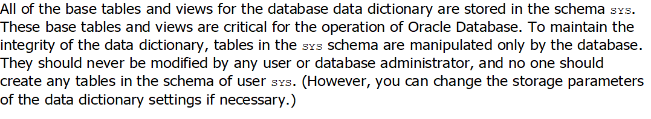
Administrative User Accounts
SYS
  When you create an Oracle database, the use SYS is automatically created and granted the DBA role.
  Don’t do anything using SYS user. Read the following for details.
Tuesday, November 26, 1999
MIS 90-728 Lecture Notes

Slide 9
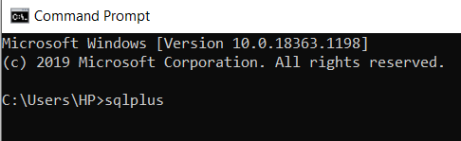
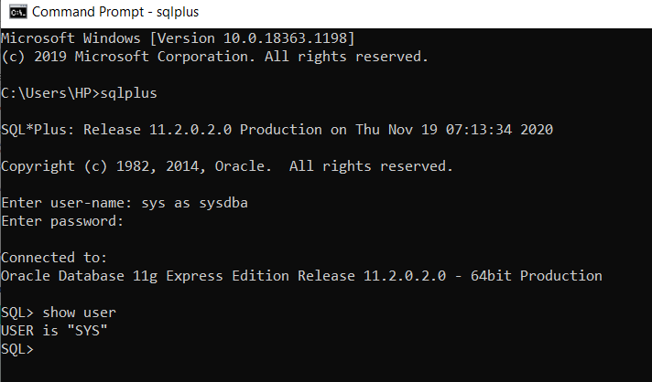
Login Database
Strat->Programe Files->Oracle database 11g express edition->Run SQL Command Line>sqlplus
Or
Start→run->cmd->sqlplus
Sqlplus
Shutdown immediate
startup

Slide 10
Writing SQL code and Run SQL
Fuction | Command
SQL Write | Sql> ed tt Save exit
SQL Run | Sql> @tt Look output
Clear Screen | Sql>cl scr;
Tuesday, November 26, 1999
MIS 90-728 Lecture Notes

Slide 11
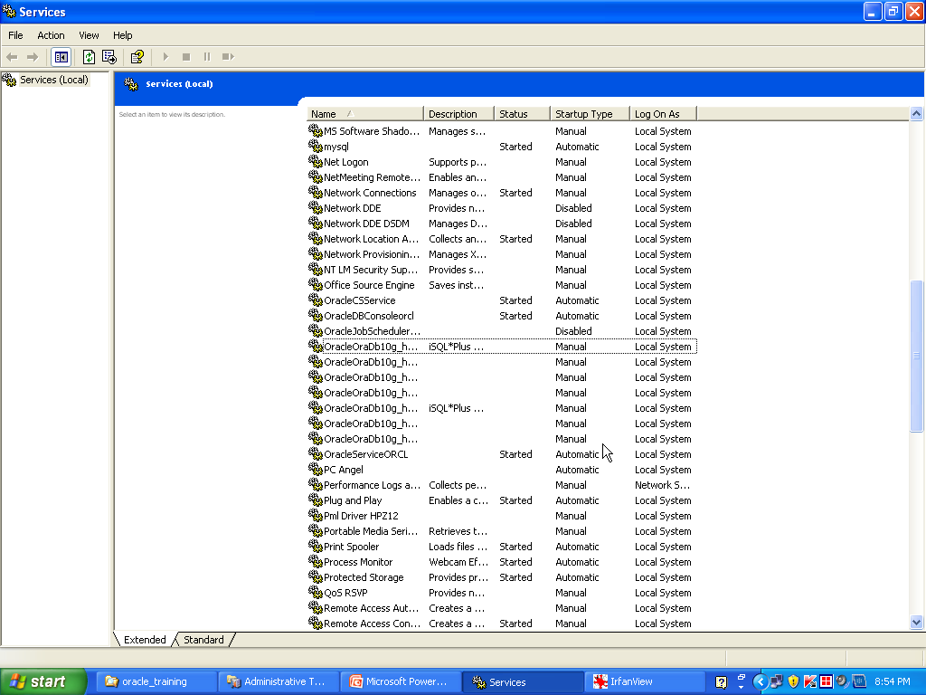
Services
Strat->Control Panel->Administrative Tools-Sevices

Slide 12
Controlling User Access
Schema: Collection of objects such as tables,views and sequences
Role- Role is named group of related privileges. Role is logical user.
System Privileges: More than 80 privileges are available and offer by DBA
  Examples are
    create session,
    create table,
    create sequence,
    create view,
    create procedure
RASHID, Dir (Admin & Fin)

Slide 13
Controlling User Access
Sql>CREATE USER RASHID IDENTIFIED BY rashid;
Sql>GRANT DBA TO rashid;
Sql>DROP USER joti;
Sql>CREATE USER joti IDENTIFIED BY joti;
Sql>GRANT CONNECT,RESOURCE TO joti;
Sql>DROP USER rashid CASCADE
RASHID, Dir (Admin & Fin)

Slide 14
Controlling User Access
DBA can grant a user specific system privileges
Sql> GRANT create table, create sequence, create view TO scott;
Role
Sql> CREATE ROLE manager;
Sql> GRANT create table, create view TO manager;
Sql> GRANT manager to rashid,joti;
RASHID, Dir (Admin & Fin)

Slide 15
Controlling User Access
Changing Password
Sql> ALTER USER scott IDENTIFIED by lion;
Object Privileges (right to perform particular action on a specific table)
Object Privileges are
  ALTER, DELTE,
  EXECUTE,
  INDEX,
  INSERT,
  REFERENCES,
  SELECT,
  UPDATE
RASHID, Dir (Admin & Fin)

Slide 16
Controlling User Access
Granting Object Privileges
Grant Query Privileges
sql> GRANT select
ON emp
TO joti, sarmin, basar;
Grant Update Privileges
Sql> GRANT update (dname, loc)
ON dept
TO scott, manager;
Grant to all user
Sql>Grant select
ON dept
TO PUBLIC;
RASHID, Dir (Admin & Fin)

Slide 17

Tuesday, November 26, 1999
MIS 90-728 Lecture Notes

